Slide 1

MISR UNIVERSITY FOR SCIENCE AND TECHNOLOGY
COLLEGE OF ENGINEERING
MECHATRONICS DEPARTMENT
MTE 405 SENSORS AND MEASUREMENTS
LAB 3 – SPRING 2019

Slide 2
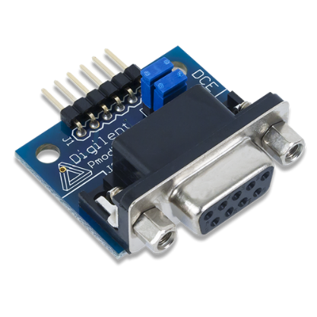
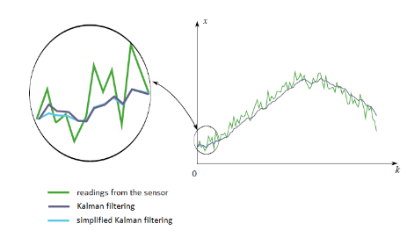
Goals Of The Lab
Lab 3
Introduction to Sensors and Signal Conditioning with Virtual Prototyping
RS-232 Serial Communication
Characteristics of
Measurements
Waleed El-Badry

Slide 3
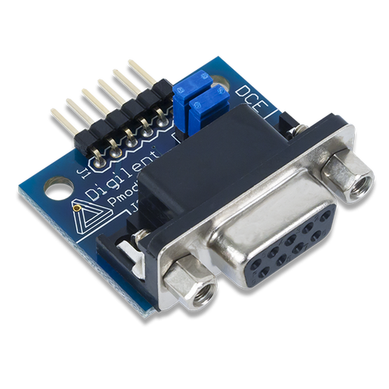
Serial Communication
Lab 3
RS-232 Protocol
Learning outcome
Serial data protocol
Acquiring sensor data.

Slide 4
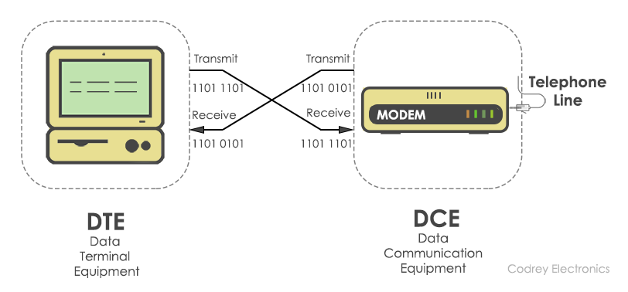
Serial Data Transfer
Lab 3
RS -232
Waleed El-Badry

Slide 5
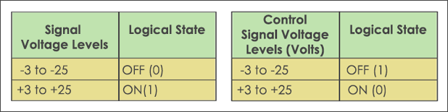
Serial Data Transfer
Lab 3
RS -232
Waleed El-Badry

Slide 6
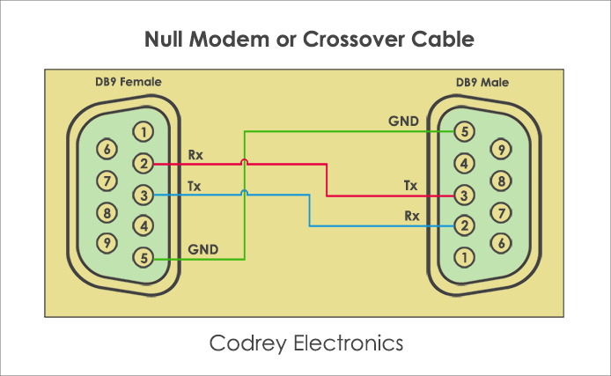
Serial Data Transfer
Lab 3
RS -232
Waleed El-Badry

Slide 7
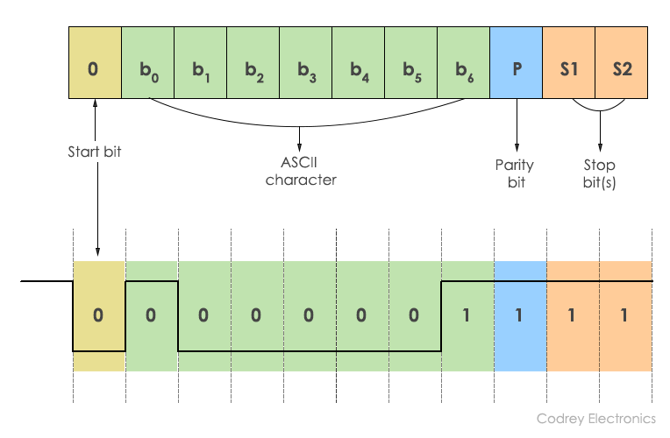
Serial Data Transfer
Lab 3
RS -232

Slide 8
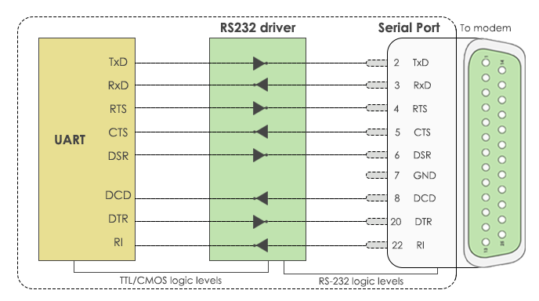
Serial Data Transfer
Lab 3
RS -232
Waleed El-Badry

Slide 9
Arduino UART
Lab 3
RS -232
void setup()
{
// Start serial port with 115200 bps
PORT.begin(115200);
}
Waleed El-Badry

Slide 10
Arduino UART
Lab 3
void serialEvent()
{
// Read command characters until \n is received
auto command = PORT.readStringUntil('\n');
command = command.substring(0, command.indexOf(','));
PORT.flush();
// Parsing command
if (command == "start")
{
// Start streaming data
Timer1.initialize(100000); // every 100 ms
//Attach ISR
Timer1.attachInterrupt(timer_one_isr);
}
if (command == "stop")
{
// Stop stream
//Attach ISR
Timer1.detachInterrupt();
}
}
RS -232

Slide 11
Arduino UART
Lab 3
RS -232
// Timer Interrupt Service Routine
void timer_one_isr()
{
//Check if simulation mode or real time mode
if (IS_SIMULATION == true)
{
// Proteus Simulation with noise
// Convert acquired LM35 voltage into temperature
lm35_temperature = (analogRead(lm35_pin) * (5.0 / 1023.0)) * (1000 / 10.0);
lm35_temperature = lm35_temperature + random(-2, 2);
PORT.println(lm35_temperature);
}
else
{
// Realtime acquisition from physical sensor
// Convert acquired LM35 voltage into temperature
lm35_temperature = (analogRead(lm35_pin) * (5.0 / 1023.0)) * (1000.0 / 10.0);
PORT.println(lm35_temperature);
}
}
Waleed El-Badry

Slide 12
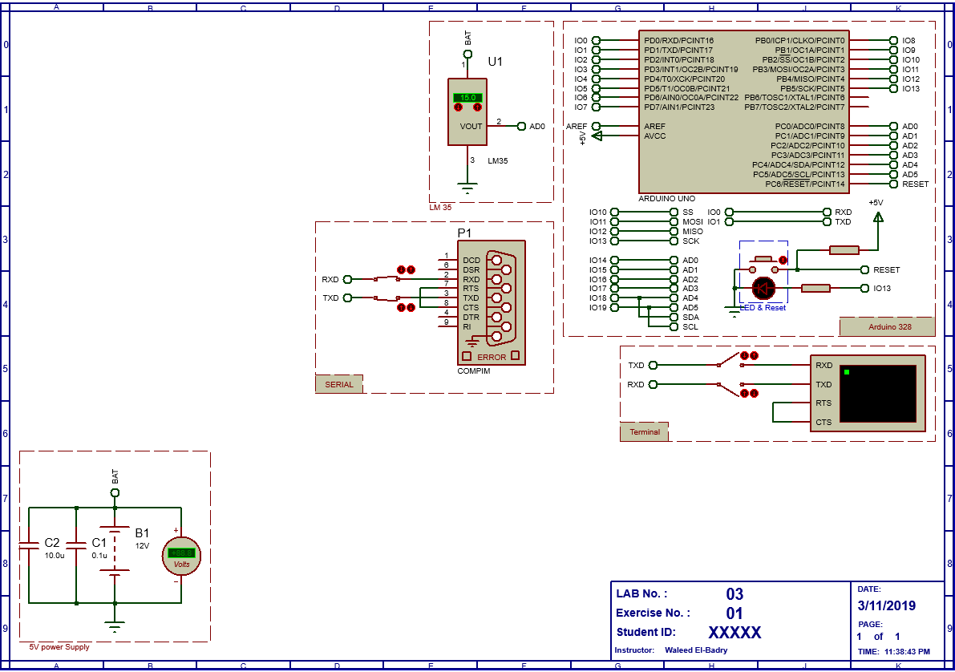
Arduino UART
Lab 3
RS -232
Waleed El-Badry

Slide 13
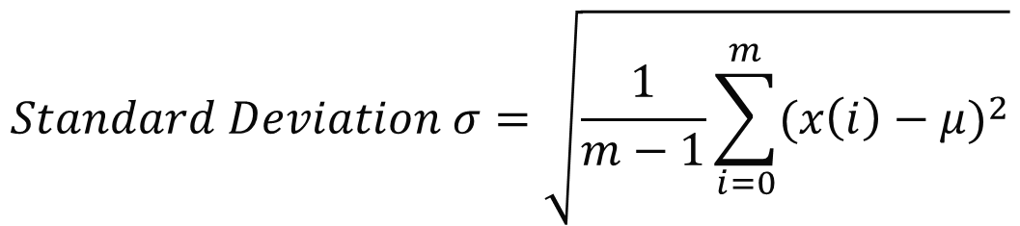
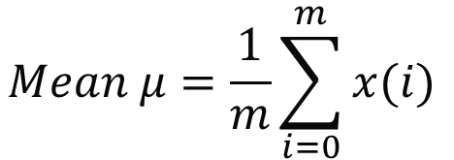
Measurements Characteristics
Lab 3
MATLAB analysis
$$Mean μ=\frac{1}{m}\sum_{i=0}^{m}{x(i)}$$
$$Standard Deviation σ=\sqrt{\frac{1}{m−1}\sum_{i=0}^{m}{{(x\left(i\right)−μ)}^{2}}}$$
$$Data Nornalization z=\frac{x − μ}{σ}→μ\left(z\right)=0 and σ\left(z\right)=0$$
Waleed El-Badry

Slide 14

Don’t forget to pull the lab update from.
http://github.com/wbadry/mte405

Slide 15
END OF Lab 3

